Slide 1
Measures of Variation

Slide 2
Measures of Variation/ Dispersion
In Statistics, Dispersion (also called variability, scatter, or spread) denotes how stretched or squeezed a distribution is
Variability is the extant to which data points in a Statistical Distribution or data set diverge from the average, or mean, value as well as the extent to which these data points differ from each other.
Following are the commonly used measures of variability
Variance
Standard Deviation
Range
Inter Quartile Range
Semi Inter Quartile Range
Mean Deviation

Slide 3
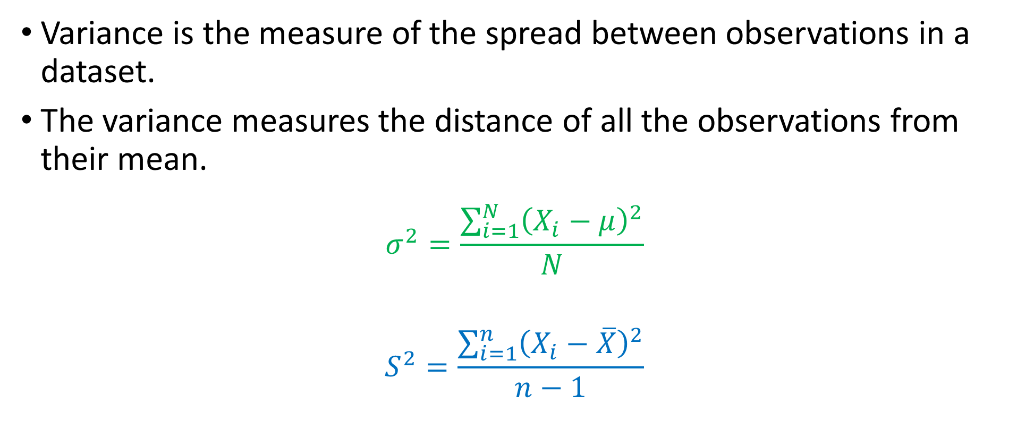
Variance
Variance is the measure of the spread between observations in a dataset.
The variance measures the distance of all the observations from their mean.
$$σ^{2}=\frac{\sum_{i=1}^{N}{{\left(X_{i}−μ\right)}^{2}}}{N}$$
$$S^{2}=\frac{\sum_{i=1}^{n}{{\left(X_{i}−\overline{X}\right)}^{2}}}{n−1}$$
Population Variance
Sample Variance

Slide 4

Standard Deviation
It is the positive square root of the Variance
$$σ=\sqrt{\frac{\sum_{i=1}^{N}{{\left(X_{i}−μ\right)}^{2}}}{N}}$$
$$S=\sqrt{\frac{\sum_{i=1}^{n}{{\left(X_{i}−\overline{X}\right)}^{2}}}{n−1}}$$
Population Standard Deviation
Sample Standard Deviation

Slide 5
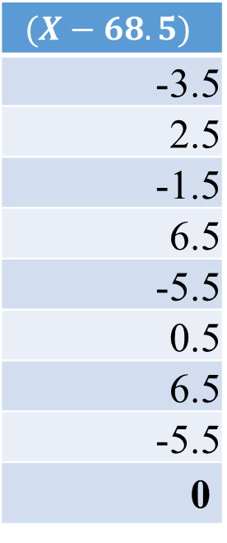


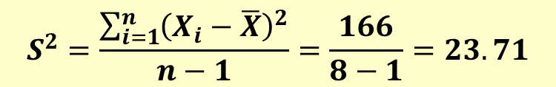
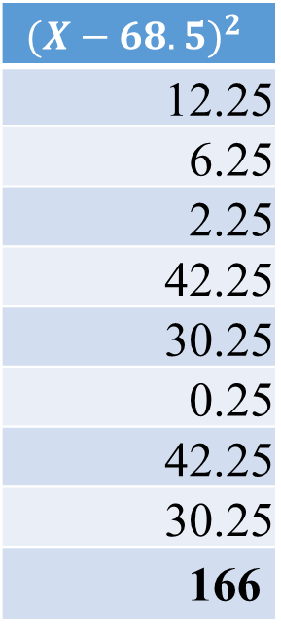
Example
X
65
71
67
75
63
69
75
63
548
$$(X−68.5)$$
-3.5
2.5
-1.5
6.5
-5.5
0.5
6.5
-5.5
0
$${(X−68.5)}^{2}$$
12.25
6.25
2.25
42.25
30.25
0.25
42.25
30.25
166
Consider the following data of yield of wheat (in kgs) from 8 experimental plots.
65, 71, 67, 75, 63, 69, 75, 63
Find the average, variance and the standard deviation of the yield.
$$\overline{X}=\frac{\sum{X}}{n}=\frac{548}{8}=68.5$$
$$S^{2}=\frac{\sum_{i=1}^{n}{{\left(X_{i}−\overline{X}\right)}^{2}}}{n−1}=\frac{166}{8−1}=23.71$$
$$S=\sqrt{23.71}=4.87$$

Slide 6
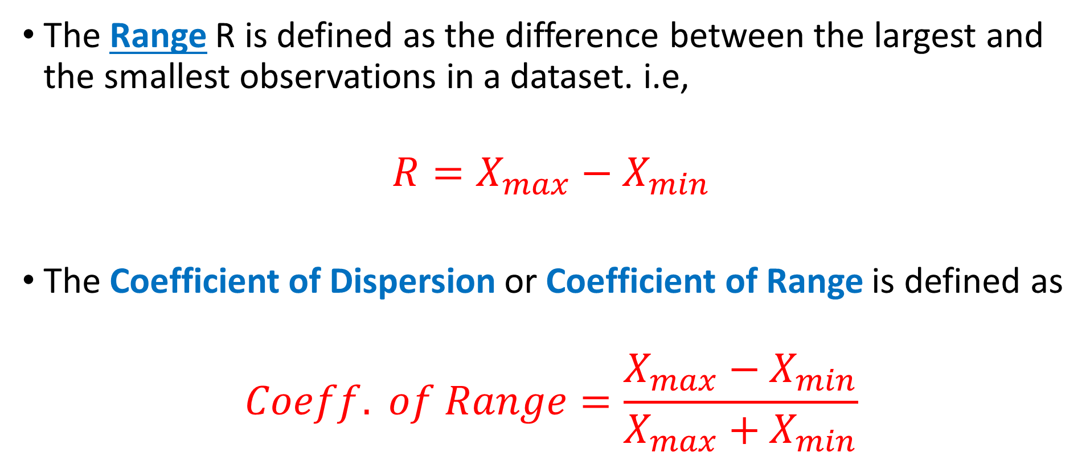
The Range & Coefficient of Range
The Range R is defined as the difference between the largest and the smallest observations in a dataset. i.e,
$$R=X_{max}−X_{min}$$
The Coefficient of Dispersion or Coefficient of Range is defined as
$$Coeff. of Range=\frac{X_{max}−X_{min}}{X_{max}+X_{min}}$$

Slide 7
Example
The marks obtained by 9 students are given below:-
45, 32, 37, 46, 39, 36, 41, 48, 36
Find the range and the Coefficient of Range.
Maximum Obs is 48 and Minimum 32, therefore
Range = 16 marks
Co-efficient of Range = 0.2

Slide 8
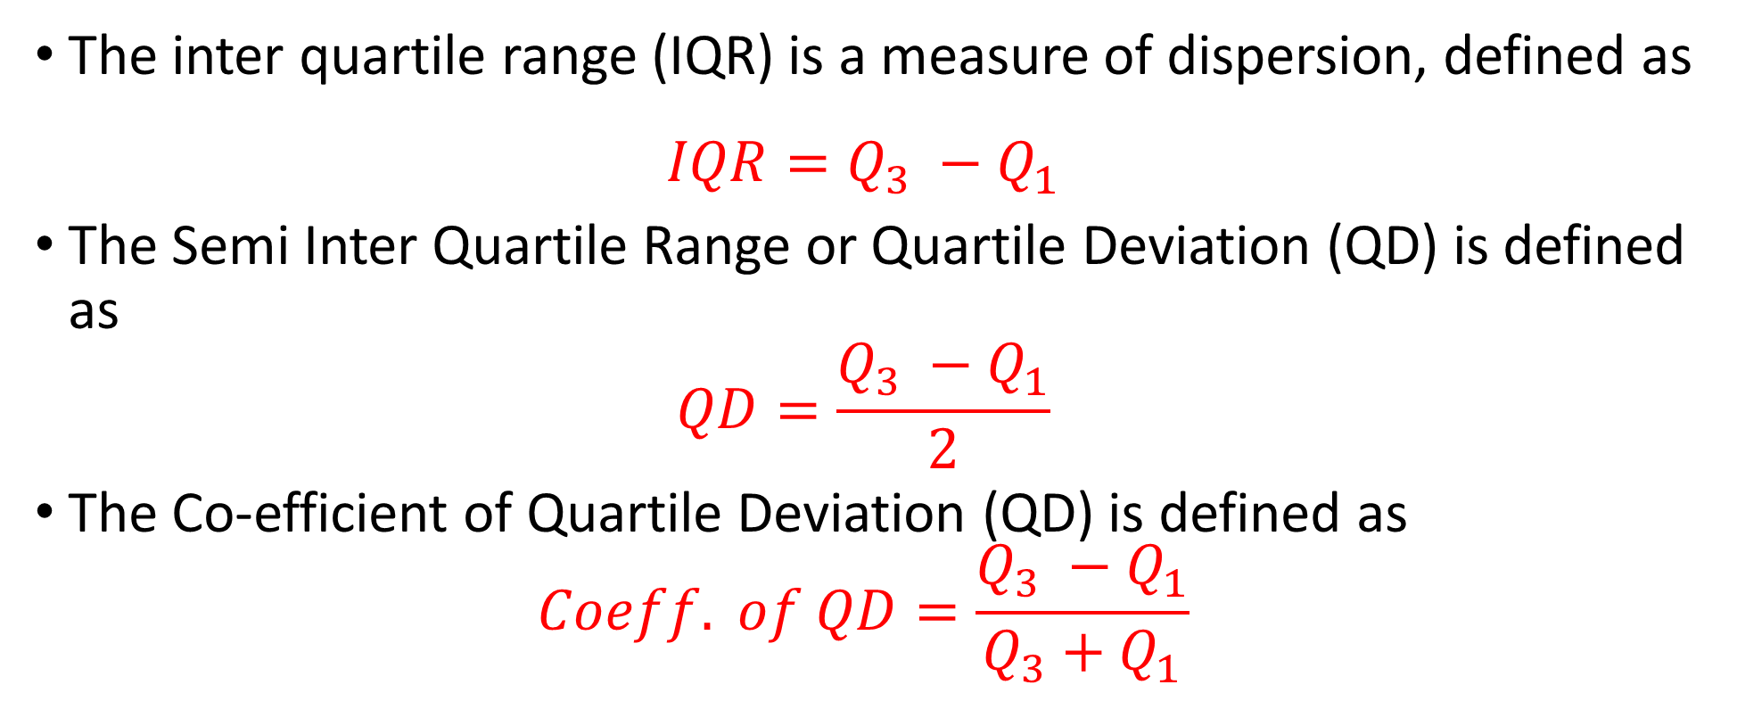
Semi Inter Quartile Range / Quartile Deviation
The inter quartile range (IQR) is a measure of dispersion, defined as
$$IQR=Q_{3} −Q_{1}$$
The Semi Inter Quartile Range or Quartile Deviation (QD) is defined as
$$QD=\frac{Q_{3} −Q_{1}}{2}$$
The Co-efficient of Quartile Deviation (QD) is defined as
$$Coeff. of QD=\frac{Q_{3} −Q_{1}}{Q_{3}+Q_{1}}$$

Slide 9
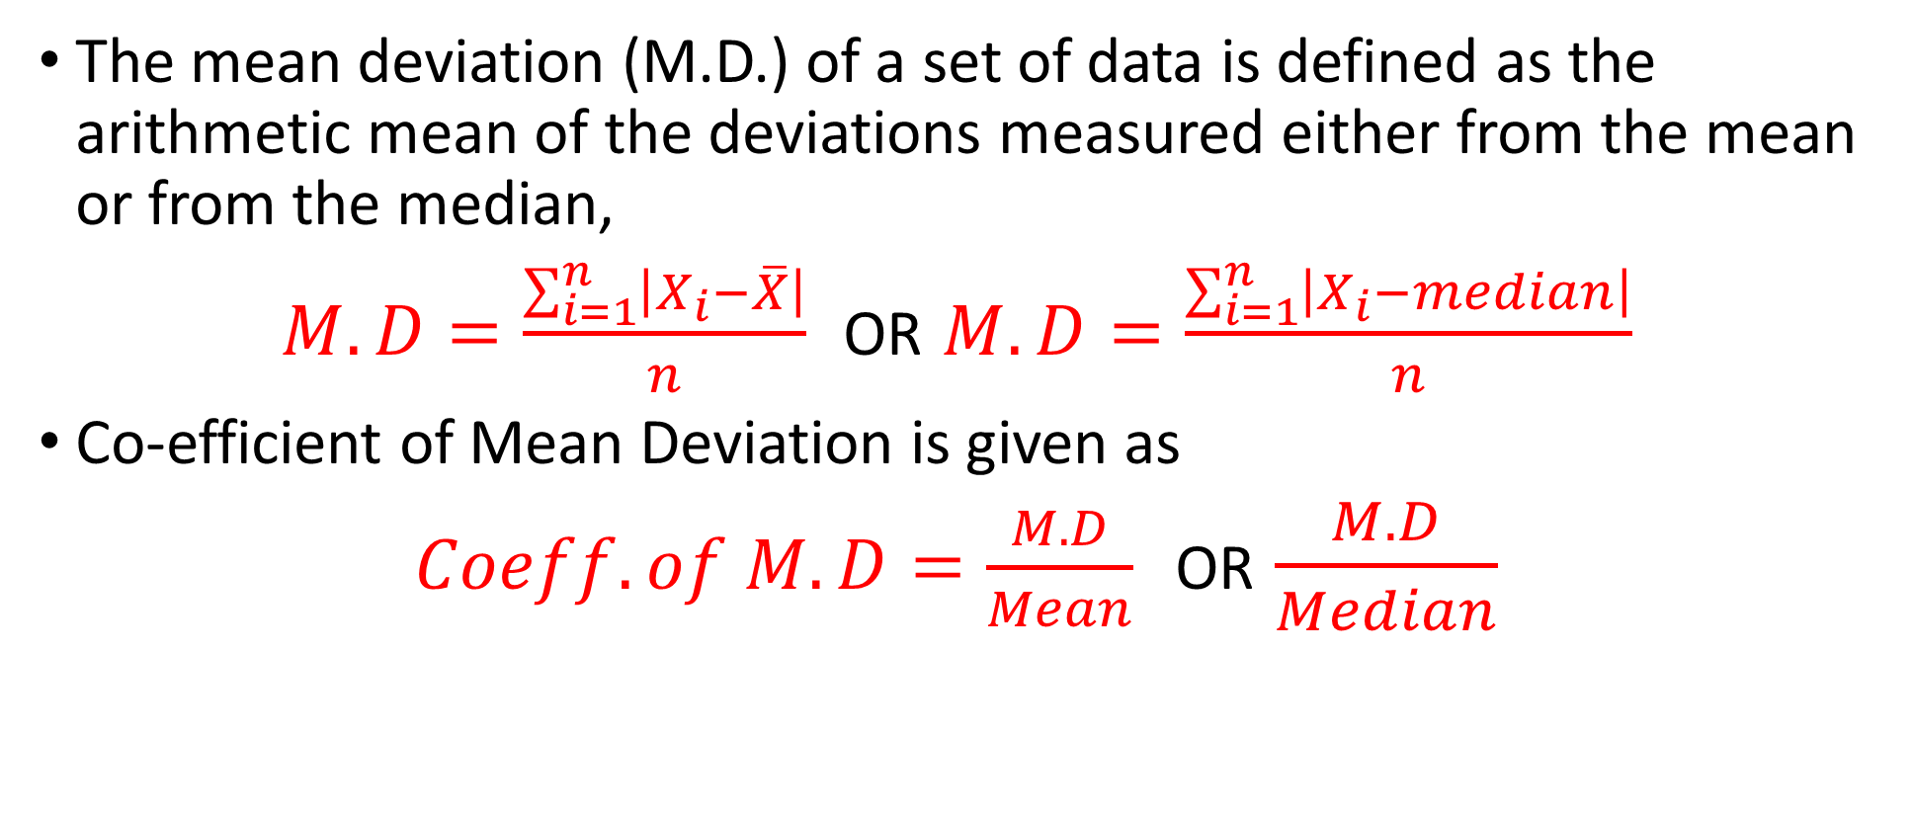
The Mean Deviation OR Average Deviation
The mean deviation (M.D.) of a set of data is defined as the arithmetic mean of the deviations measured either from the mean or from the median,
$M.D=\frac{\sum_{i=1}^{n}{\left|X_{i}−\overline{X}\right|}}{n}$ OR $M.D=\frac{\sum_{i=1}^{n}{\left|X_{i}−median\right|}}{n}$
Co-efficient of Mean Deviation is given as
$Coeff. of M.D=\frac{M.D}{Mean}$ OR $\frac{M.D}{Median}$

Slide 10
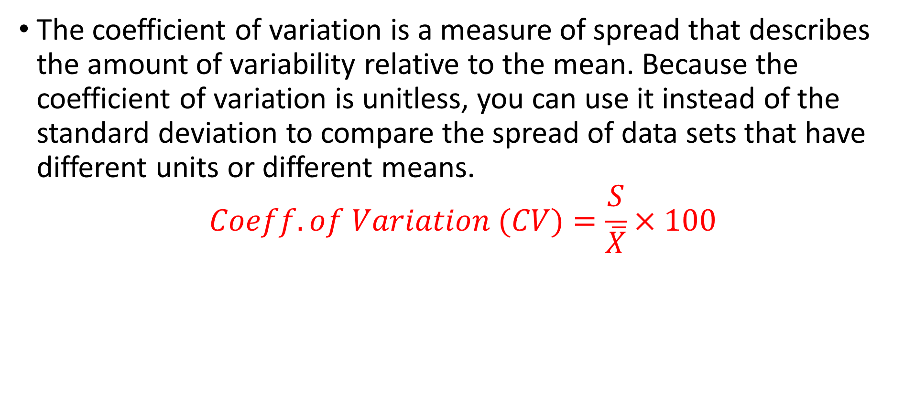
Co-efficient of Variation (CV)
The coefficient of variation is a measure of spread that describes the amount of variability relative to the mean. Because the coefficient of variation is unitless, you can use it instead of the standard deviation to compare the spread of data sets that have different units or different means.
$$Coeff. of Variation (CV)=\frac{S}{\overline{X}}×100$$

Slide 11
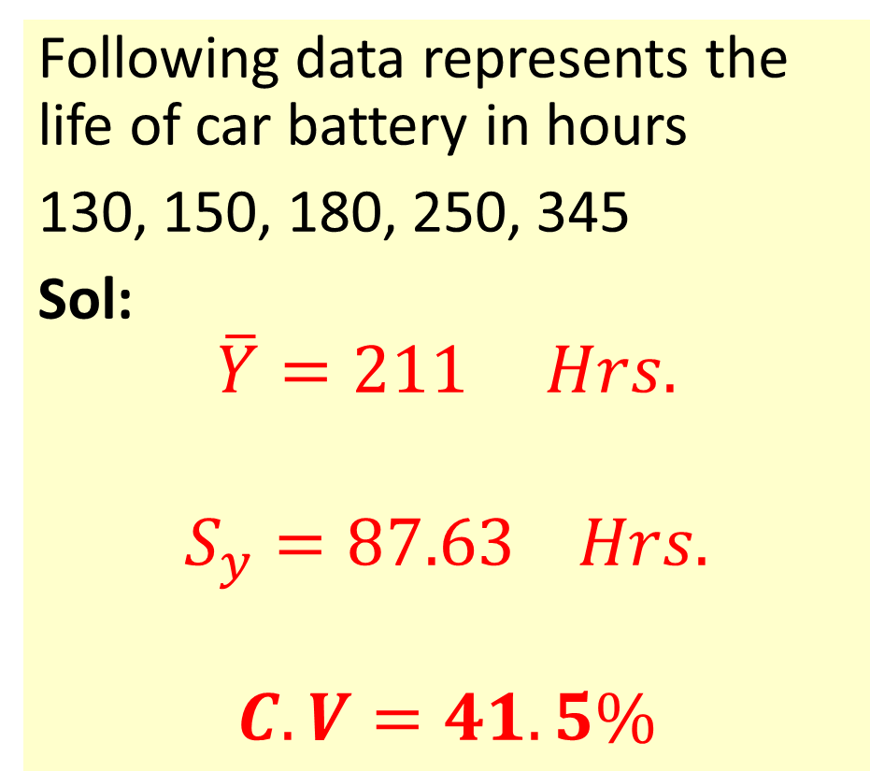
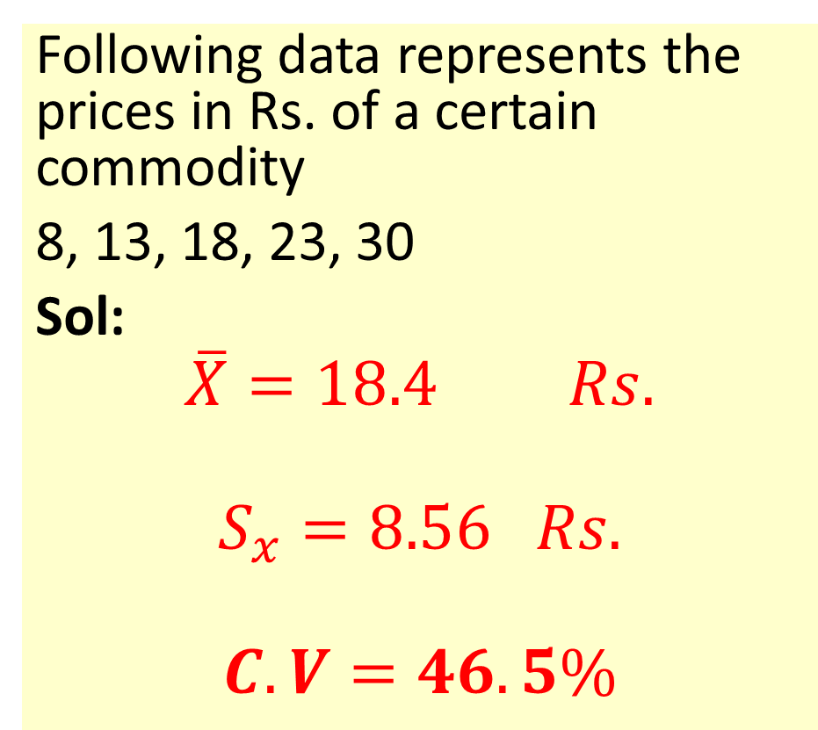
Example
Following data represents the prices in Rs. of a certain commodity
8, 13, 18, 23, 30
Sol:
$$\overline{X}=18.4 Rs.$$
$$S_{x}=8.56 Rs.$$
$$C.V=46.5\%$$
Following data represents the life of car battery in hours
130, 150, 180, 250, 345
Sol:
$$\overline{Y}=211 Hrs.$$
$$S_{y}=87.63 Hrs.$$
$$C.V=41.5\%$$

Slide 12
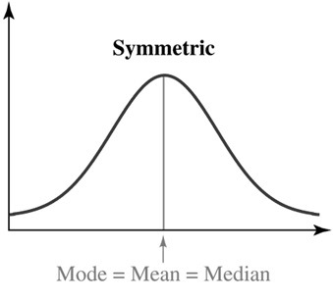
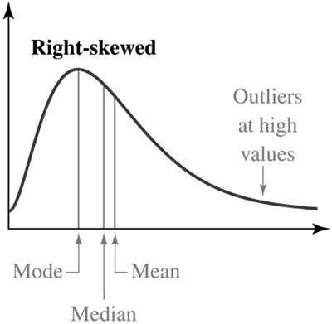
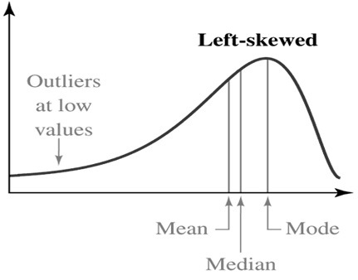
Types of Distribution

Slide 13
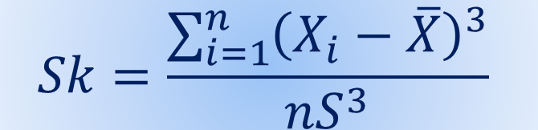
Measures of Skewness
Skewness is a measure of symmetry, or more precisely, the lack of symmetry. A distribution, or data set, is symmetric if it looks the same to the left and right of the center point. The Coefficient of Skewness is given as
If Sk = 0 the distribution is Symmetrical
If Sk ⟩ 0 the distribution is +vely skewed
If Sk ⟨ 0 the distribution is -vely skewed
$$Sk=\frac{\sum_{i=1}^{n}{{\left(X_{i}−\overline{X}\right)}^{3}}}{nS^{3}}$$

Slide 14
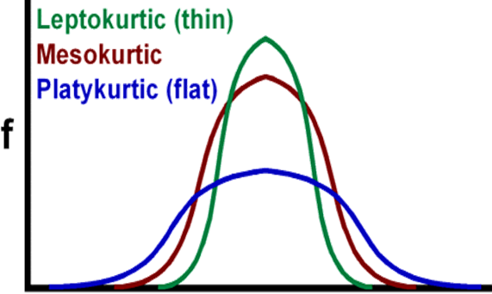
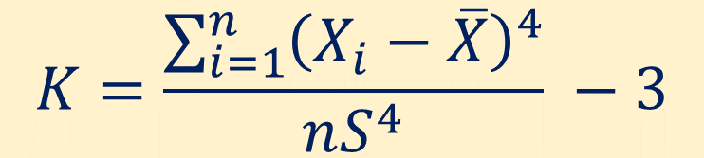
Measures of Kurtosis
Describes the extent of peakedness or flatness of the distribution of the data.
Measured by Coefficient of Kurtosis (K) computed as,
$$K=\frac{\sum_{i=1}^{n}{{\left(X_{i}−\overline{X}\right)}^{4}}}{nS^{4}} −3$$

Slide 15
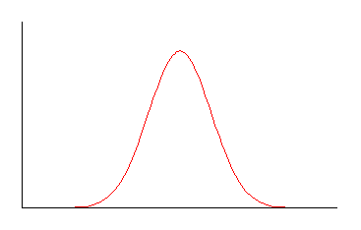
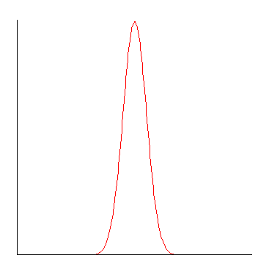
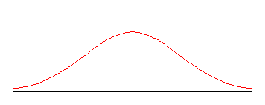
Interpretation
K = 0
mesokurtic
K > 0
leptokurtic
K < 0
platykurtic

Slide 16
Example
Consider the following data:-
25, 27, 29, 31, 33, 35, 37
Find Mean, Variance, Coefficient of Skewness and Coefficient of Kurtosis and interpret the results.
Variance | 18.67
Standard Deviation | 4.32
Kurtosis | -1.2
Skewness | 0
Range | 12
Minimum | 25
Maximum | 37
Sum | 217

Slide 17
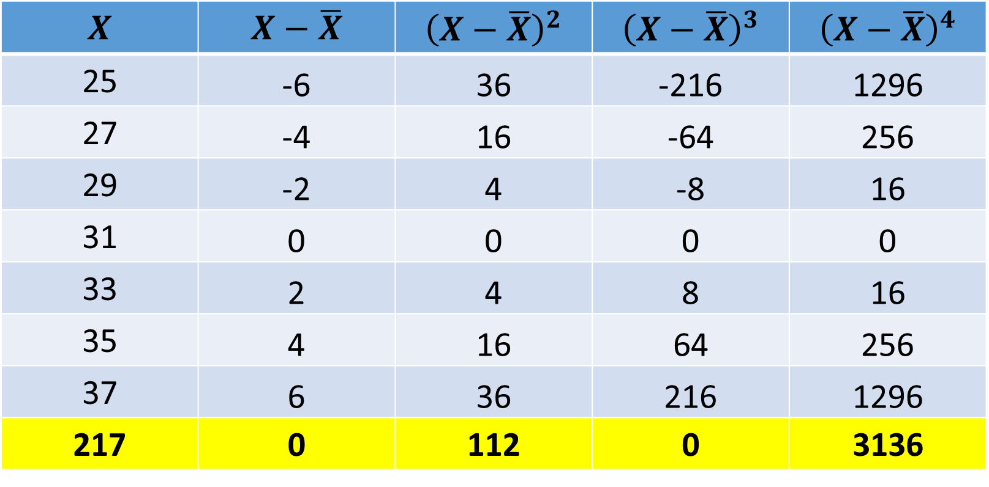
How to do it…
$$X$$ | $$X−\overline{X}$$ | $${\left(X−\overline{X}\right)}^{2}$$ | $${\left(X−\overline{X}\right)}^{3}$$ | $${\left(X−\overline{X}\right)}^{4}$$
25 | -6 | 36 | -216 | 1296
27 | -4 | 16 | -64 | 256
29 | -2 | 4 | -8 | 16
31 | 0 | 0 | 0 | 0
33 | 2 | 4 | 8 | 16
35 | 4 | 16 | 64 | 256
37 | 6 | 36 | 216 | 1296
217 | 0 | 112 | 0 | 3136

Slide 18
Five Number Summary
For a set of data, the minimum, first quartile, median, third quartile, and maximum.
Minimum, Q1, Median, Q3, Maximum

Slide 19
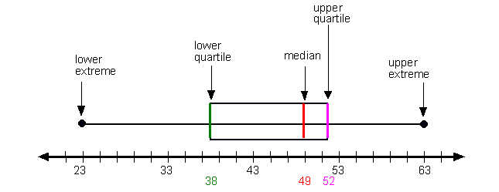
Boxplot / Box & Whisker plot
Line within box( median) indicates average size of the data
Length of graph / box indicates variation in the data
Position of line within box indicates the shape of the data
Line at the center of the box indicates data is symmetrical
Line above the center of the box indicates data is -vely skewed
Line below the center of the box indicates data is +vely skewed

Slide 20
Example
Consider the following data of marks of 20 students:-
Construct Boxplot of the data and interpret it.
Minimum = 20
Q1 = 36.25
Median = 54.5
Q3 = 73
Maximum = 94
53 | 74 | 82 | 42 | 39 | 28 | 20 | 81 | 68 | 58
54 | 93 | 70 | 30 | 61 | 55 | 36 | 37 | 29 | 94

Slide 21
Question
The breaking strength of 20 test pieces of a certain alloy is given as:-
95, 97, 96, 73, 78, 95, 89, 68, 82, 79, 69, 67, 83, 94, 87, 93, 103, 108, 117, 130
Calculate the average breaking strength of the alloy and the standard deviation. Calculate the percentage of observations lying within the limits:-
(i) Mean ± S
(ii) Mean ± 2S
(iii) Mean ± 3S
Mean 90.15
Variance S² = 269.08
SD S = 16.4

Slide 22
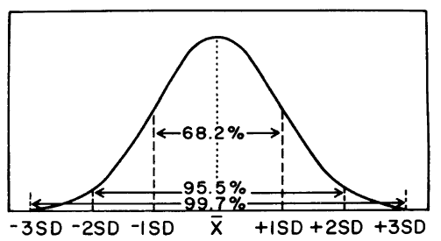
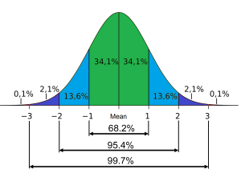
Characteristics of Normal Curve: About 68 percent of the observations fall between plus and minus one SD from the mean; about 95 percent fall between plus and minus two SD from the mean; and about 99 percent fall between plus and minus three SD from the mean.

Slide 23
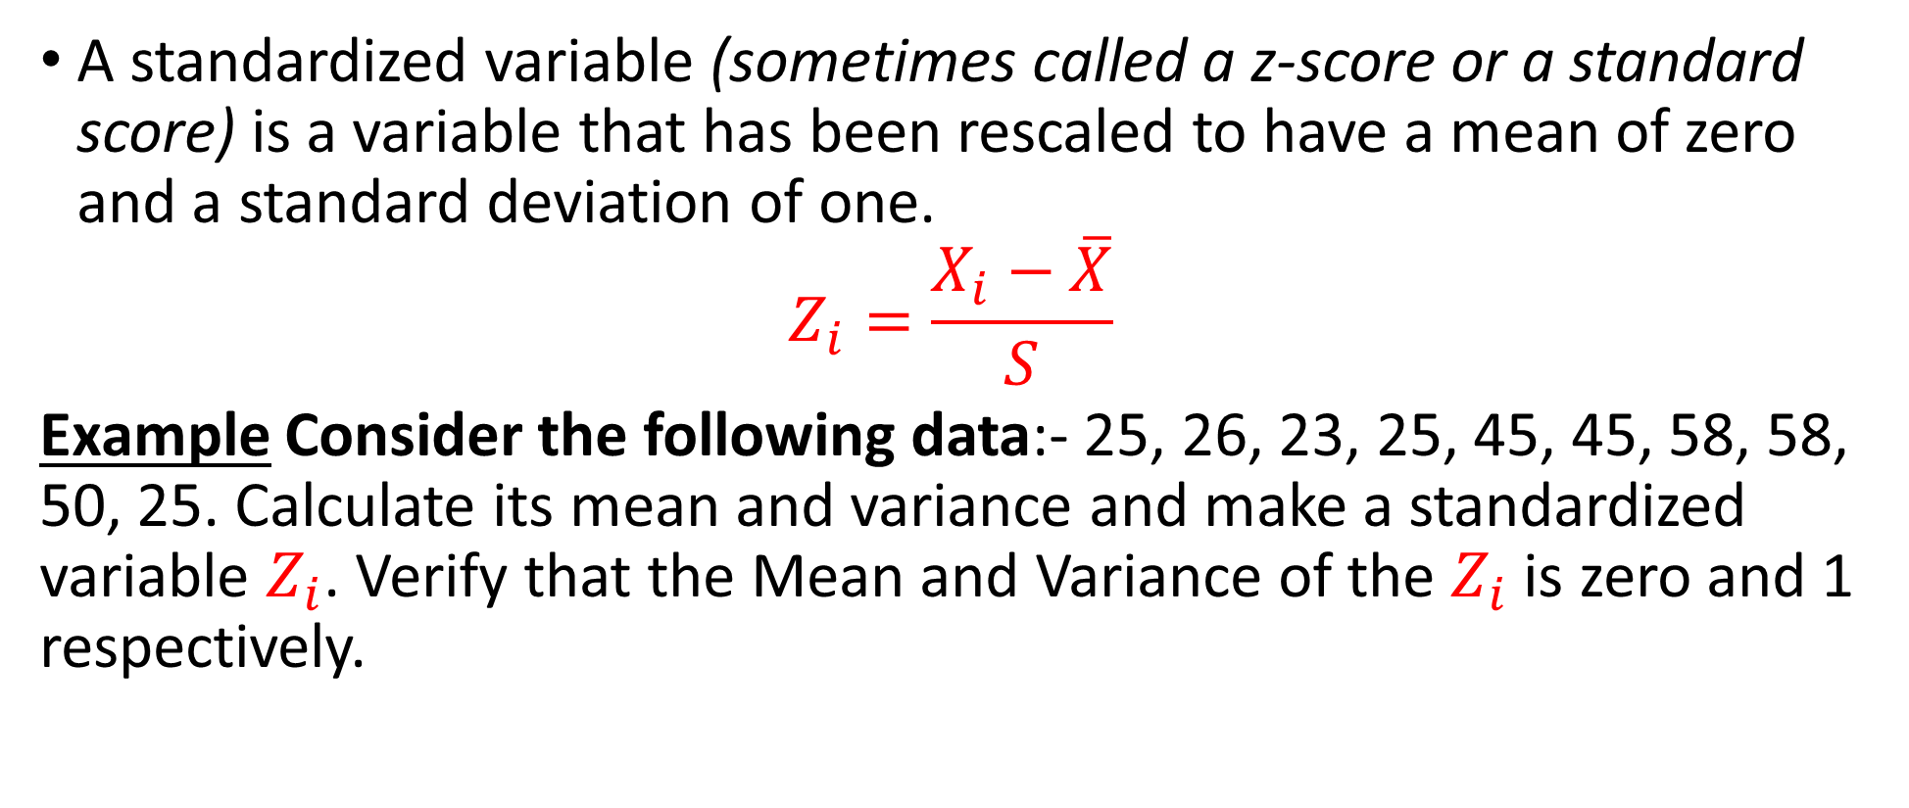
Standardized Variable
A standardized variable (sometimes called a z-score or a standard score) is a variable that has been rescaled to have a mean of zero and a standard deviation of one.
$$Z_{i}=\frac{X_{i}−\overline{X}}{S}$$
Example Consider the following data:- 25, 26, 23, 25, 45, 45, 58, 58, 50, 25. Calculate its mean and variance and make a standardized variable $Z_{i}$. Verify that the Mean and Variance of the $Z_{i}$ is zero and 1 respectively.

Slide 24
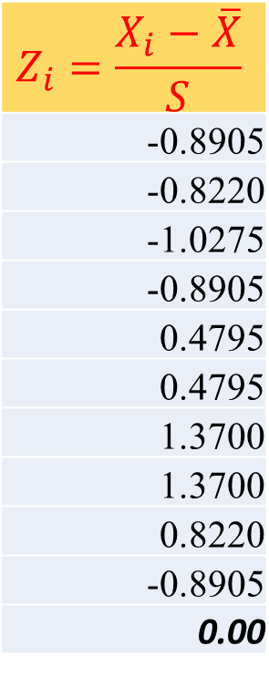
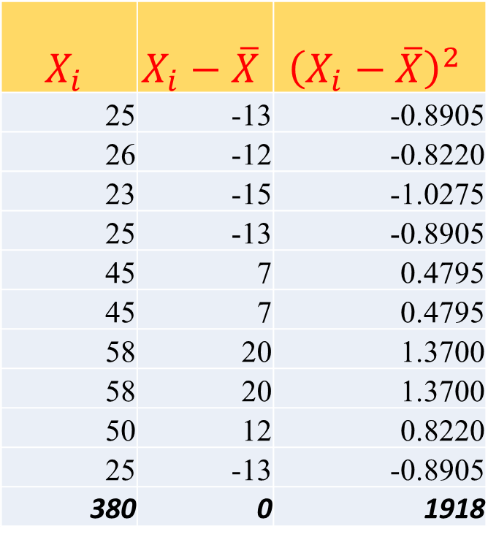
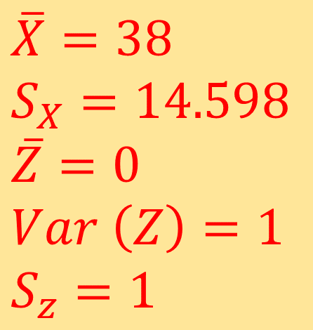
Solution
$$X_{i}$$ | $$X_{i}−\overline{X}$$ | $${\left(X_{i}−\overline{X}\right)}^{2}$$
25 | -13 | -0.8905
26 | -12 | -0.8220
23 | -15 | -1.0275
25 | -13 | -0.8905
45 | 7 | 0.4795
45 | 7 | 0.4795
58 | 20 | 1.3700
58 | 20 | 1.3700
50 | 12 | 0.8220
25 | -13 | -0.8905
380 | 0 | 1918
$$Z_{i}=\frac{X_{i}−\overline{X}}{S}$$
-0.8905
-0.8220
-1.0275
-0.8905
0.4795
0.4795
1.3700
1.3700
0.8220
-0.8905
0.00
$$\overline{X}=38 \\ S_{X}=14.598 \\ \overline{Z}=0 \\ Var \left(Z\right)=1$$
$$S_{z}=1$$

